Slide 1
Hand-controlled car
project

Slide 2
Team
Mohamed tarek Mohamed
Sara Ahmed Hossam
Alaa Kamal Abdelrahman
Mohamed Sabry Beshir
Abdullah Khaled Saber

Slide 3
Components used:
The project splitied into two parts:
ATMEGA32 with 16Mhtz Crystal
RC-CAR Kit
LCD 16*2
L298n dual H-bridge for controlling dc motors (5v voltage regulator included)
(at least) 2*dc motor
2*Lithium battery
Hc-05 Bluetooth module
On Hand part:
ATMEGA32 with 16Mhtz Crystal
9v battery and 5v voltage regulator
5*flex sensor
Hc-05 Bluetooth module

Slide 4
How the Project works:
The idea is very simple:
All that happening is that the two Bluetooth module connected to each other by getting the mac address of the slave module (which the connected to the car) and make the master (which is the connected in the hand) connects to it.
The hand part is programmed for fixed positions of the fingers as getting from the flex sensor as angles (as we will discuss later).
When the microcontrollers receive the programed position, the master Bluetooth module sends a char (like ‘f’, ‘s’) and the master Bluetooth module receives it and the microcontroller in the car translates it into motor motion as programmed.
The program is always checking the character sent from the master.

Slide 5
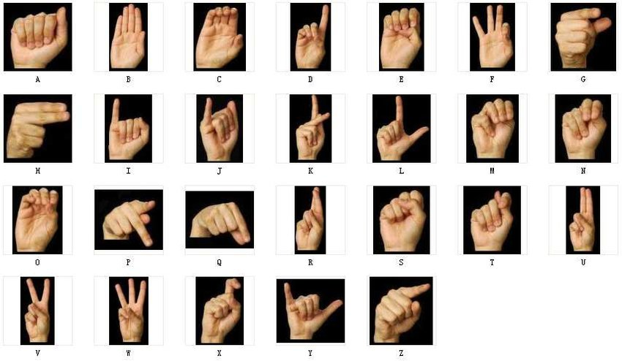
The programed gestures
Forward
Right
Stop
Left
Backward

Slide 6
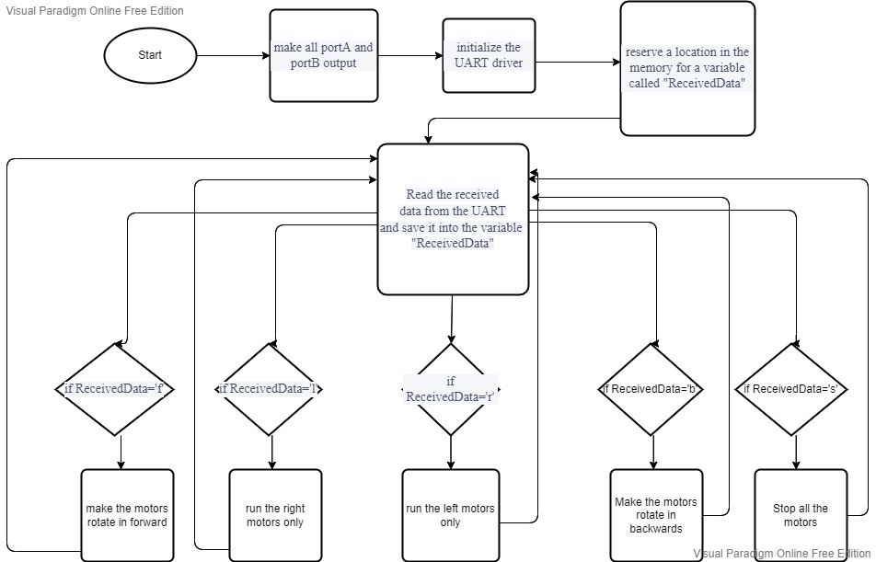
Flow chart of the car part

Slide 7
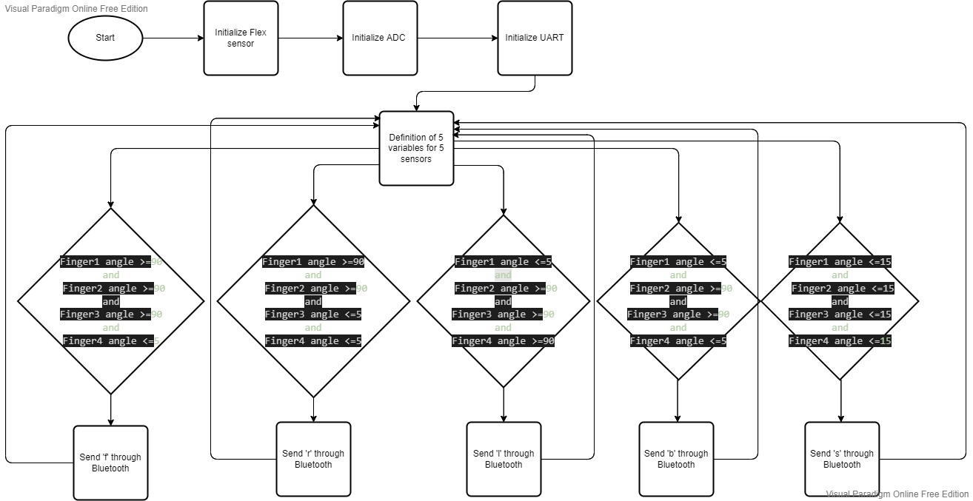
Flow chart of the hand part

Slide 8
The drivers that used in the project
MCAL (Microcontroller Libraries):
DIO
ADC
UART
HAL (Hardware libraries):
LCD
Flex Sensor
L298n H-Bridge.

Slide 9
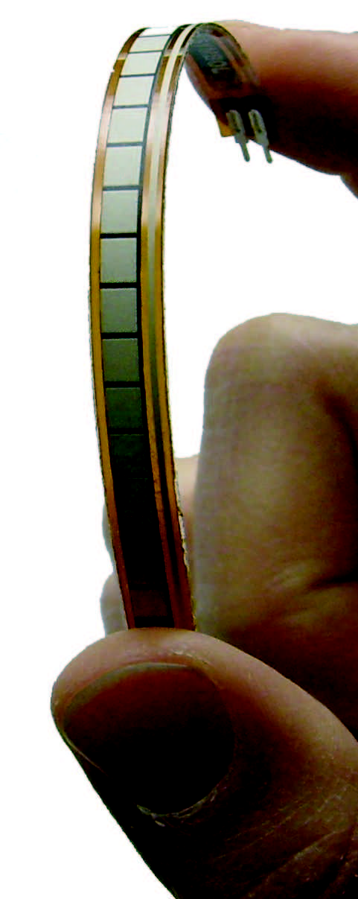
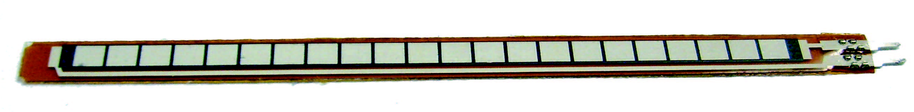
How is the flex sensor work
The flex sensor is like a variable resistance that gives different voltage readings because of bending and voltage dividing which with it, we can process using Map function and Analog-to-digital converter.
All we need to know about the strait resistance and 90degree resistance and the input voltage of the sensor.
The reading of the sensor after processing is the angle
of the sensor.

Slide 10
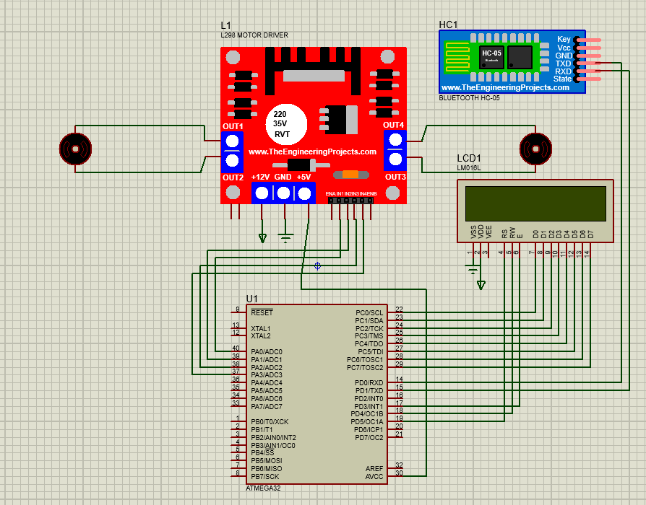
Schematic of car-part wiring

Slide 11
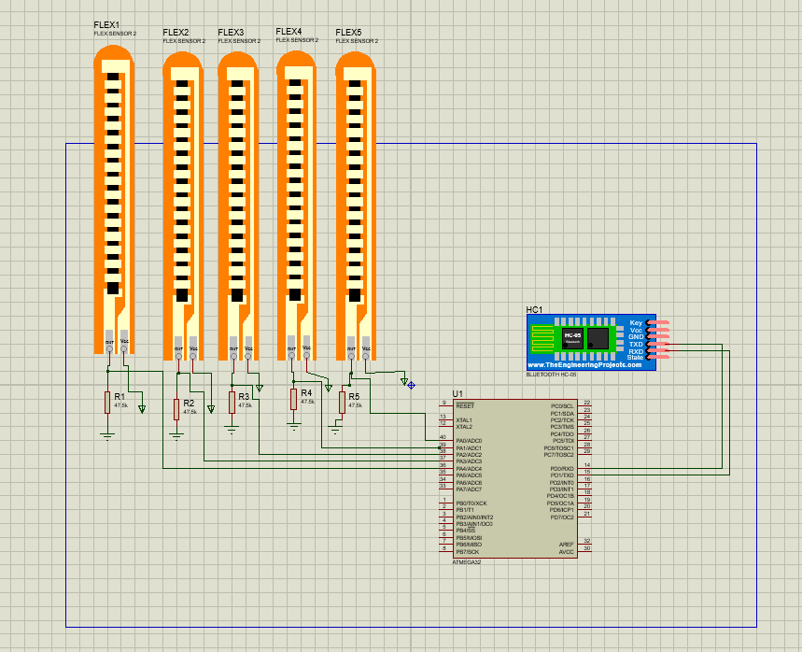
Schematic of hand-part wiring

Slide 12

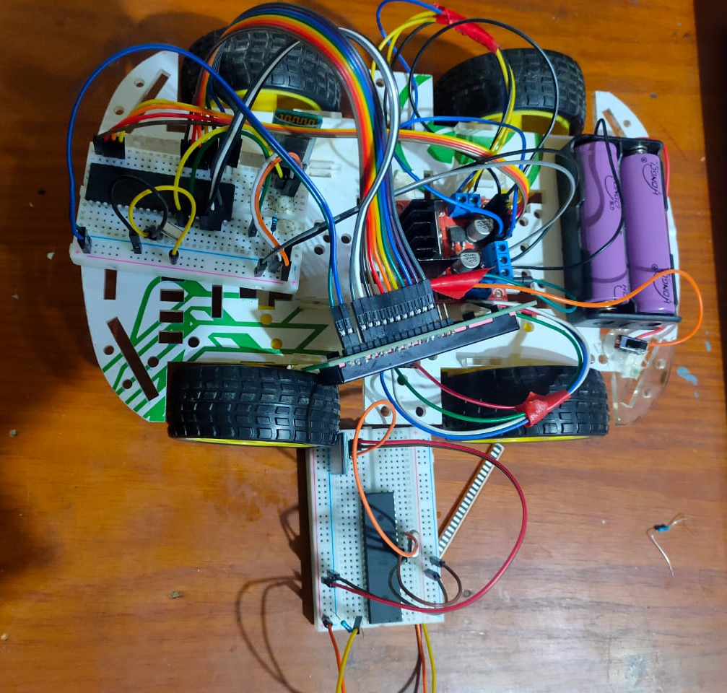
Photo of the Project
In this photo, used all the components mentioned above
“except for the Bending sensor. In the photo there is only 1 but we have all 5 in real”

Slide 13
References and external links
Flex sensor tutorial and datasheet
Flex Sensor Hookup Guide - learn.sparkfun.com
How to pair two Bluetooth module with each other
Getting Bluetooth modules talking to each other – Zak's Electronics Blog ~* (zakkemble.net)
How to use l298n driver
How to Use L298N Motor Driver | Microcontroller Tutorials (teachmemicro.com)
Voltage regulator usage
How to Connect a Voltage Regulator in a Circuit (learningaboutelectronics.com)

